Slide 1
How to use KiCAD to output copper traces and other useful information
By: Franco Harding

Slide 2

Install KiCAD
Version 6+ for Windows: https://www.kicad.org/download/windows/
Download and install Github version (more stable)

Slide 3
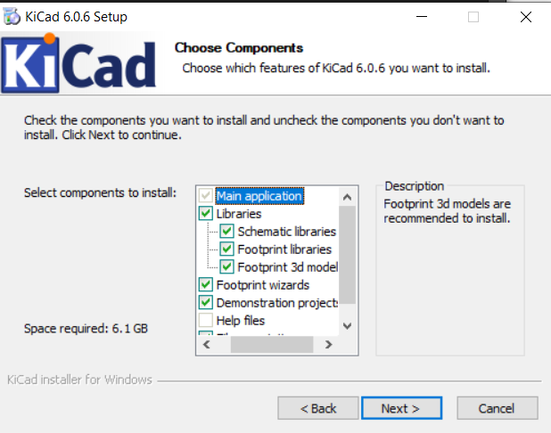
Setting up KiCAD
Installing libraries is optional but recommended, as it gives better variety in the components used for each schematic

Slide 4
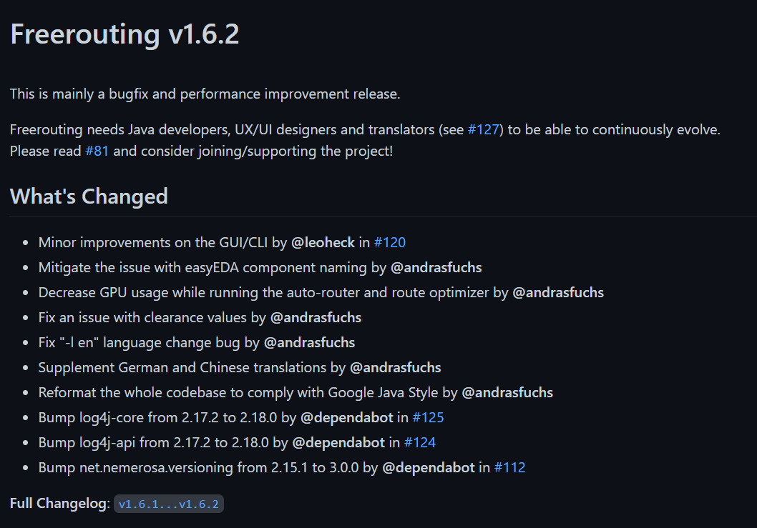
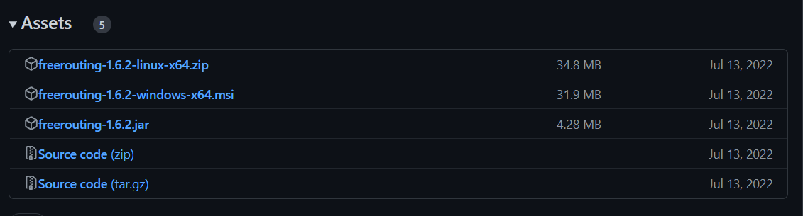
Install Autorouting
To make use of the autorouting software used in testing install freerouting (v1.6.2): https://github.com/freerouting/freerouting/releases

Slide 5
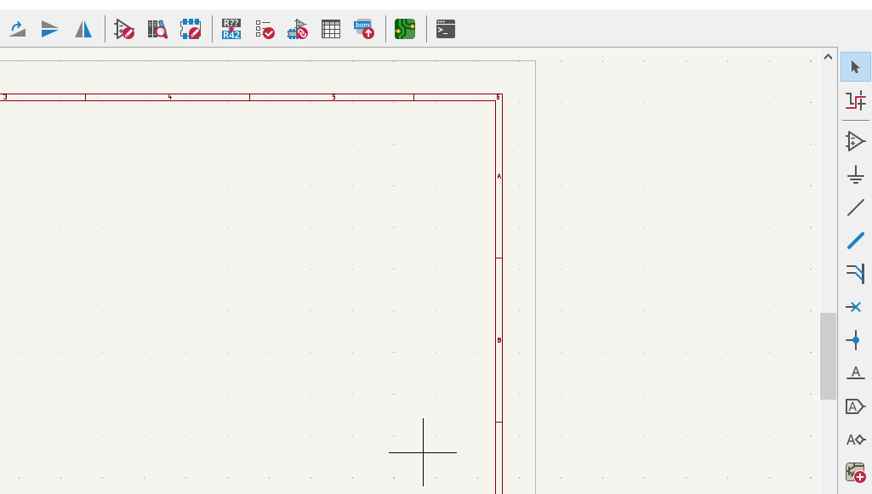
Autoroute schematic
Open schematic with schematic editor in KiCAD.
Create a PCB file using the “Open PCB in board editor button at the top right of the screen in the schematic editor.

Slide 6

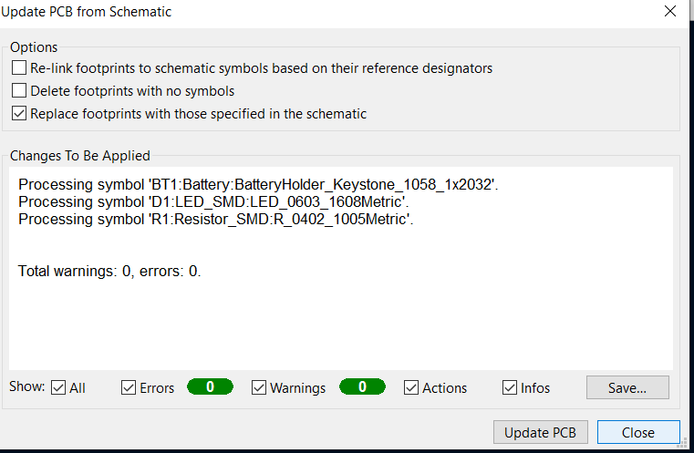
Autoroute schematic
Import schematic to PCB editor by going to Tools > Update PCB from Schematic and selecting Update PCB on the pop-up window.
The schematic should now be available on the PCB Editor. It can be selected and dragged to a better position if the default is not appropriate.

Slide 7
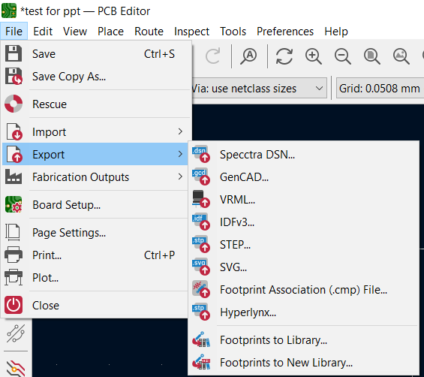
Autoroute Schematic
To autoroute the PCB using the freerouting software it needs to be exported as a .dsn file. To export as a .dsn file go to File > Export > Specctra Session.

Slide 8
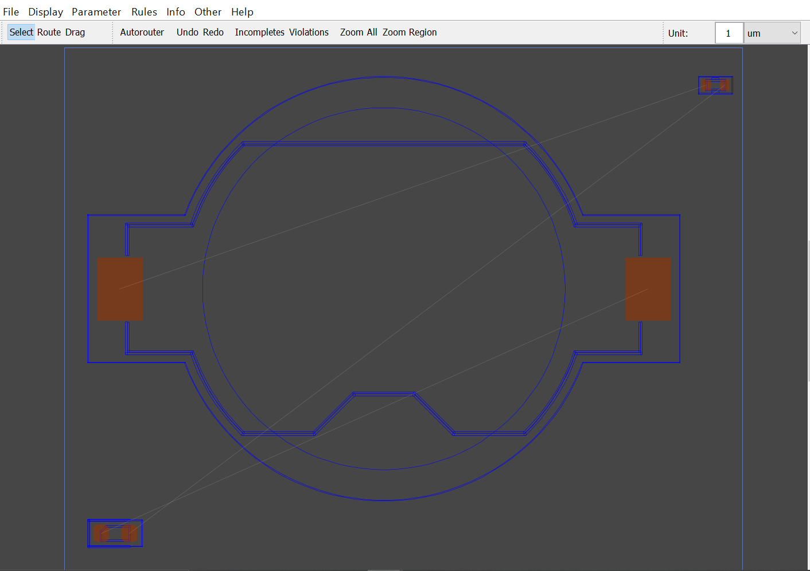
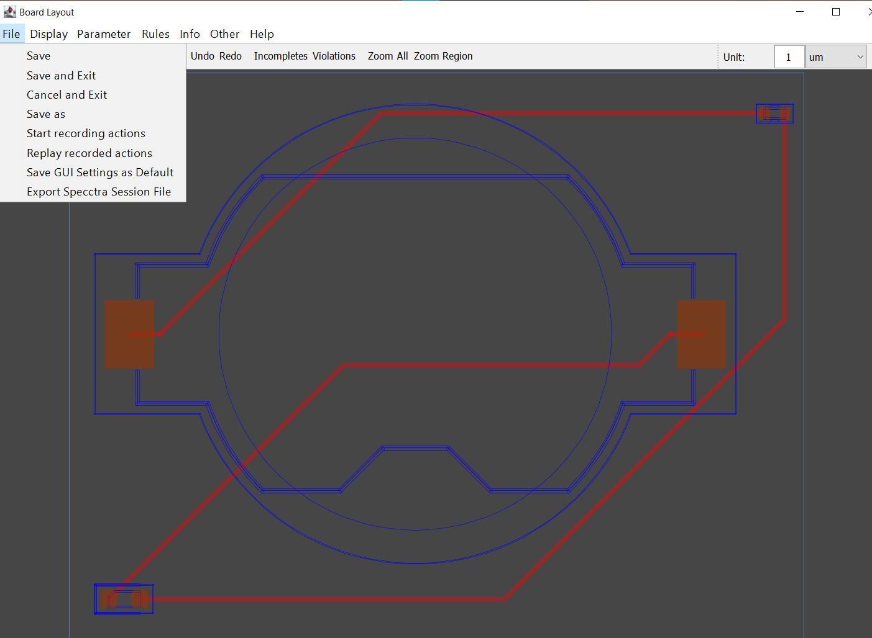
Autorouting Schematic
Open freerouting and select the previously exported .dsn file by clicking “Select Design File”.
To route the components together press “Autorouter” until satisfactory results are achieved.
Export the file from freerouting by going to File > Export Specctra Session File.

Slide 9
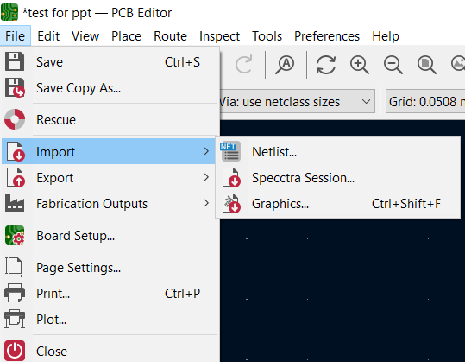
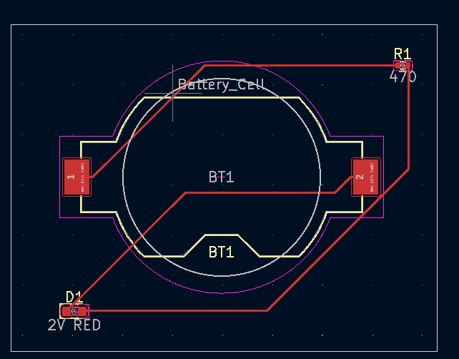
Autorouting Schematic
To update the PCB with the newly routed PCB, open the previous PCB file on the PCB Editor and import the output from the freerouting software (should be a .ses file).
To import go to File > Import > Specctra Session and open the .ses file. It should update the routing.

Slide 10
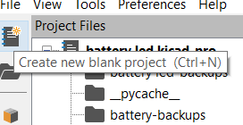
Open KiCAD
Open KiCAD app and press create new blank project on the sidebar or CTRL+N to start using KiCAD.
Open PCB Editor to get a view of the PCB Editor

Slide 11
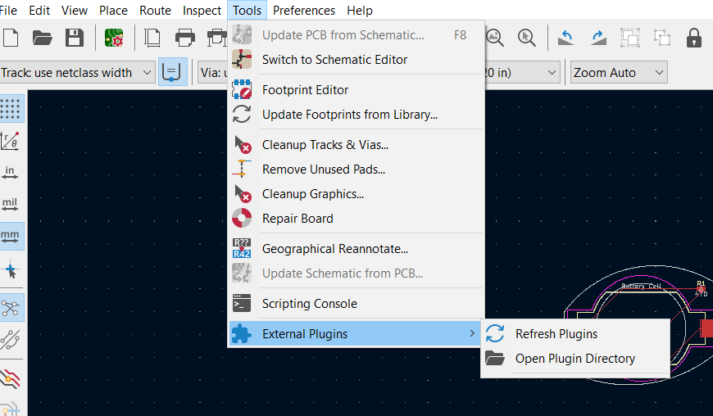
Install Project Scripts
Unzip ProjectScripts.zip from documentation into the plugin directory of KiCAD.
Plugin directory can be accessed by opening the PCB Editor, navigate to Tools > External Plugins > Open Plugin Directory

Slide 12
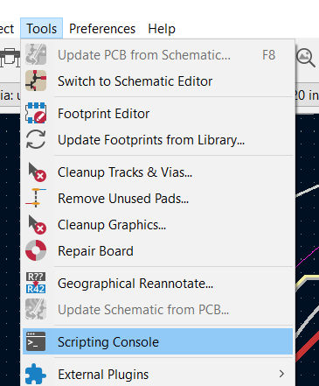
Import Copper Traces
Open Project in PCB Editor.
Go to Tools > Scripting Console, this will open the Python console embedded in KiCAD.
Write “import test_net” and press enter

Slide 13
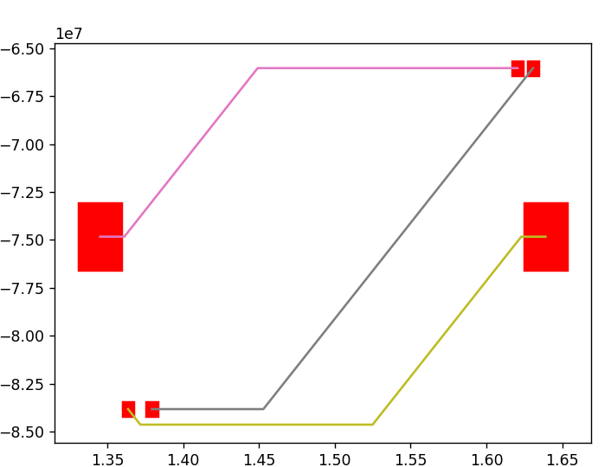
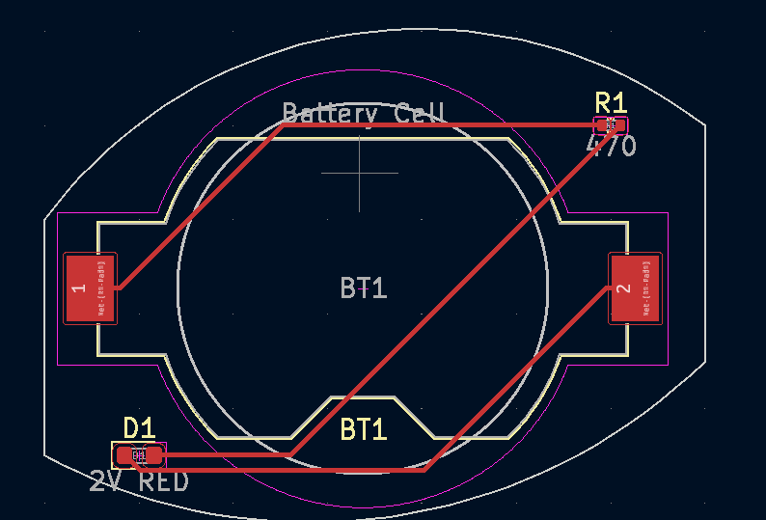
Result of Copper Trace and Pads

